Slide 1
Integrating Classroom Bullying into Instructional Practices
Sally Vogl-Bauer, PhD
Cathy Gillotti, PhD
NCA 2016 Short Course – Philadelphia, PA

Slide 2
Goals of Today’s Workshop
First Half of Workshop
  To identify opportunities to integrate bullying concepts in course curricula
  To explore ways to converge NCA’s Core Competencies with bullying concepts
  To provide tools for applying bullying concepts into the classroom
Second Half of Workshop
  To review K-12 intervention models and best practices
  To explore the role of classroom, department, and institution culture in the approach institutions take to bullying

Slide 3
Bullying Defined
“…Bullying behavior is defined as the subjecting of a victim
  to repeated negative actions
  intended to cause discomfort or injury
  over an extended duration of time
  by a perpetrator who holds real or perceived advantage in physical, psychological, or social power over the victim” (Elpus & Carter, 2016).

Slide 4
The Bullying Landscape in Education
In an attempt to understand bullying better, it is also important to remember that:
  Bullying takes many different forms
  Bullies may or may not know their targets
  You don’t have to be “weak” to be the target of bullying
  Determining the role of power can be complicated

Slide 5
Making Bullying Relevant in Communication Courses
There are many logical links and associations that can be made:
  Bullying entails both verbal and nonverbal messages
  Bullying is an interpersonal communication activity
  Bullying involves the use or abuse of power
  Bullying has ethical implications

Slide 6
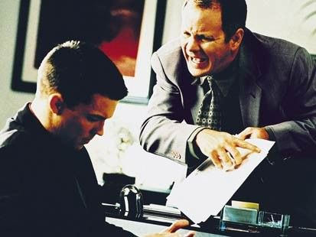
  Here are some additional things to think about…
What aspect of bullying do you want to address?
How much time do you have to dedicate to the subject?
How would this content support course learning outcomes?

Slide 7
Curricular Options
Freshman Experience Course (FYE)
Your Institution’s Basic Course
Interpersonal Communication
Small Group Communication
Dark Side of Interpersonal Communication
Conflict & Negotiation
Organizational Communication
Communication & Social Media

Slide 8
  Integrating NCA’s Core Competencies with Bullying Concepts
Monitoring and Presenting Your Self
Practicing Communication Ethics
Adapting to Others
Practicing Effective Listening
Expressing Messages
Identifying and Explaining Fundamental Communication Processes
Creating and Analyzing Message Strategies

Slide 9
Applying Bullying Concepts into the Classroom
Sticks & Stones – www.tolerance.org
Uppers/Downers/Vultures – Wood (2004)
Buckets of Water/Candy
Internal Monologue – Wood (2004)

Slide 10
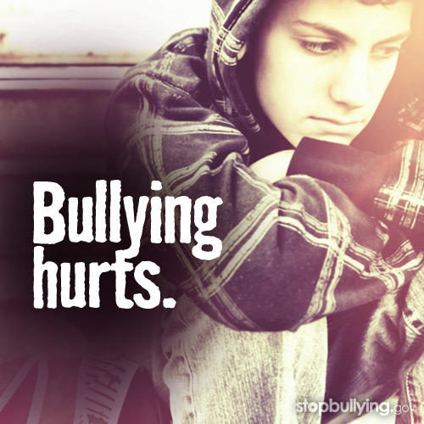
Image by www.stopbullying.org

Slide 11
A Review of K-12 Intervention Models & Best Practices
Vreeman & Carroll (2007) did a meta-analysis of K-12 intervention programs
5 categories of programs include:
  Curriculum interventions
  Multi-disciplinary/whole school
  Targeted social/behavioral skills
  Mentoring
  Increased social work support

Slide 12
Curriculum Interventions
Curricular interventions included things such as videotapes, lectures, and/or written curriculum which varied in intensity from a single videotape viewing followed by class discussion to a 15-week module
Results showed that these programs did not consistently decrease bullying
(Vreeman & Carroll, 2007)

Slide 13
Whole-School Interventions
Whole-school interventions included a combination of school-wide rules and sanctions, teacher training, classroom curriculum, conflict resolution, and individual counseling.
Overall, – studies showed positive effect on a reduction in bullying when whole-school interventions were implemented.
(Vreeman & Carroll, 2007)

Slide 14
Additional Whole-School
Intervention Findings
The Olweus Bullying Prevention Program has reported 30-70% reductions in student reports of bullying, and has been the model from which other programs have been tailored.
However Vreeman & Carroll (2007) found two studies with disparate results in evaluation of this program – both in Norway.

Slide 15

Bottom Line from
Vreeman & Carroll (2007)
“In conclusion, fairly consistent evidence suggests that children’s bullying behavior can be significantly reduced by well-planned interventions” (p.87).
Image by www.stopbullying.org

Slide 16
Role of Teacher
Veenstra, Lindenberg, Huitsing, Sainio, & Salmivalli (2014) conducted a study of 2,776 4th-6th graders and found that students’ perceptions of their teachers’ efficacy in decreasing bullying was related to lower levels of peer-related bullying.
This study was based on Goal-Framing Theory.
  This theory notes that “goals that are focused on the way one feels (like gaining status and affection) can be inhibited by the activation of the over-arching goal to act socially appropriately in a particular situation” (p. 1136).

Slide 17
An Elephant in the Living Room?
Cultural environments often determine the extent to which bullying behaviors are:
  Explicitly discouraged and addressed
  Implicitly discouraged and addressed
  Explicitly encouraged
  Implicitly encouraged

Slide 18
Classroom Environments
Student Behaviors:
  Is the bully aware of what he/she is doing?
  Is the target aware of what is going on?
  Are other students aware of what is going on?
  How are the students responding?
Instructor Behaviors:
  Is the instructor aware of what is going on between students?
  Is the instructor aware of what is going on between them and their students?
  How is the instructor responding?

Slide 19
Department Culture
What are the department norms and rules associated with incivility?
  What types of behaviors are encouraged vs. discouraged?
  What types of behaviors are enabled vs. empowered?
  Does the department have any formal policies addressing classroom bullying?
How does the department handle issues related to other types of bullying that may be taking place within the department?

Slide 20
Institutional Culture
What does the Student Handbook say about bullying and incivility?
What do the Faculty Personnel Rules say about bullying and incivility?
Are there any problematic behaviors that are either explicitly or implicitly ignored?
In either instance, where is the burden of proof?

Slide 21
Institutional Procedures
Purdue University Northwest
Report an incident/person of concern form
‪www.pnw.edu/dean-of-students/
Explained in TA training

Slide 22


Slide 23
Safe Zone
The Safe Zone program aims to create a visible network of support for LGBTQ individuals and their allies by providing an avenue through which any member of the Purdue University Northwest Community can show their support. The program also creates an educational experience through the Safe Zone Workshop.
The Safe Zone program encourages student, faculty, and staff to explore cultural identity, values, and stereotypes in order to better understand how these issues impact the university, surrounding community and LGBTQ communities.

Slide 24
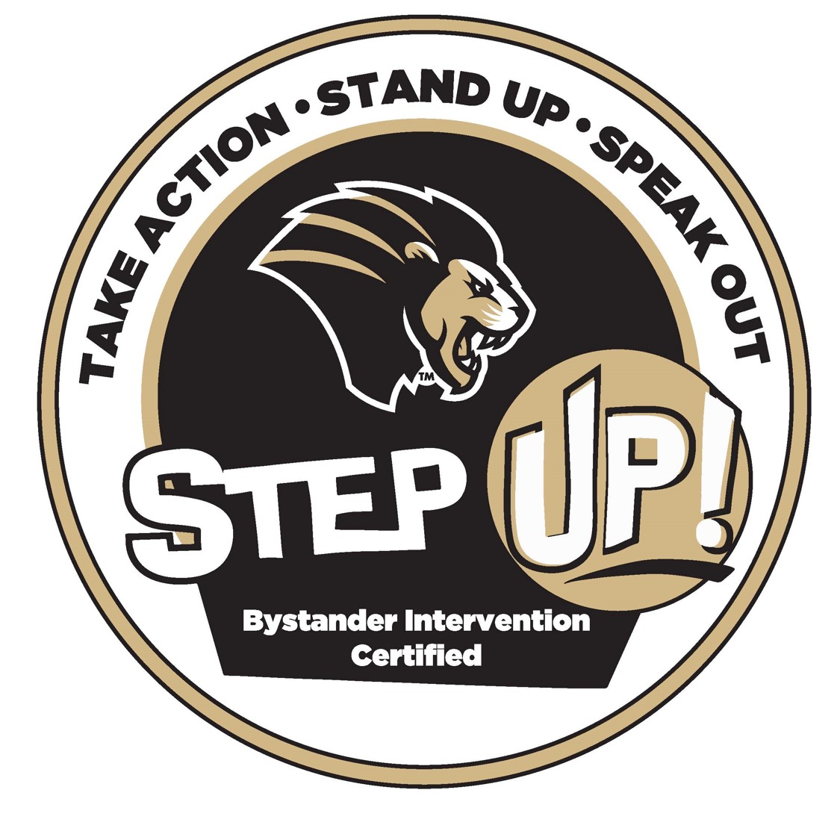

Slide 25
Step Up! Bystander Intervention
You can actively help prevent incidents before they occur and help to keep your friends safe. Purdue University Northwest Step UP! program which was developed by the University of Arizona and the NCAA raises awareness, provides skills and educates people to recognize the continuum of violence.
Through training bystander intervention empowers and mobilizes participants to recognize, intervene, prevent and/or stop inappropriate comments, actions and behaviors. The entire campus community plays a valuable role in preventing acts that violate the basic dignity of an individual.

Slide 26
“We’re all just walking each other home.”
Ram Dass

Slide 27
References
Brown, B. (2015). Rising strong: The reckoning, the rumble, the revolution. New York: Spiegel and Grau.
Coopman, S.J. & Wood, J.T. (2004). Instructors manual for Wood’s Interpersonal communication: Everyday encounters. Belmont, CA: Wadsworth/Thomon Learning.
Elpus, K. & Carter, B.A. (2016). Bullying victimization among music ensemble and theatre students in the United States. Journal of Research in Music Education, 64)
Hanh, T.N. (2013). The art of communicating. New York, NY: Harper Collins.

Slide 28
References
Valenzano, J.M., Broeckelman-Post, M.A., Parcell, E.S. (2016). Communication pathways. Southlake, TX: Foutainhead Press.
Veenstra, R., Lindenberg, S., Huitsing, G., Sainio, M., & Salmivalli, C. (2014). The role of teachers in bullying: The relation between anti-bullying attitudes, efficacy, and efforts to reduce bullying. Journal of Educational Psychology, 106. 1135-1143.
Vreeman, R.C. & Carroll, A.E. (2007). A systematic review of school-based interventions to prevent bullying. Archives of Pediatric Medicine, 161, 78-88.
www.pnw.edu
www.stopbullying.org
www.tolerance.org

