Slide 1

Is that how they see me
Day 3
Femininity and Masculinity
Richard T. Craig, PhD
George Mason University

Slide 2
Gender…
Connell (1987)
  Gender divided by three areas
    Labor
    Power
    Cathexis (emotional connection)
Yakali-Camoglu (2018)
  Heteronormative needs to regulate identities as feminine and masculine to prevail.

Slide 3

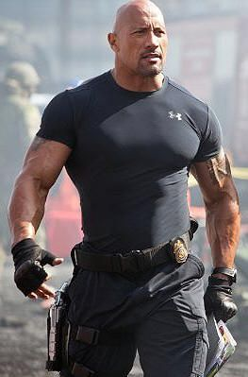
Masculinity
Hanke (1998)
  …masculinity is what a culture expects of its men.
    Craig (1992) media images are at the center of that discourse
Connel (1987)
  Multiple masculinities
    Not unitary or univocal
      Hegemonic masculinity dominates all…

Slide 4
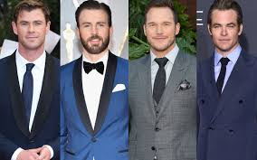
Masculinity
Hegemonic Masculinity
  Masculinity understood in traditional terms
    White
    Middle-class
    Heterosexual
    Professional-Managerial

Slide 5
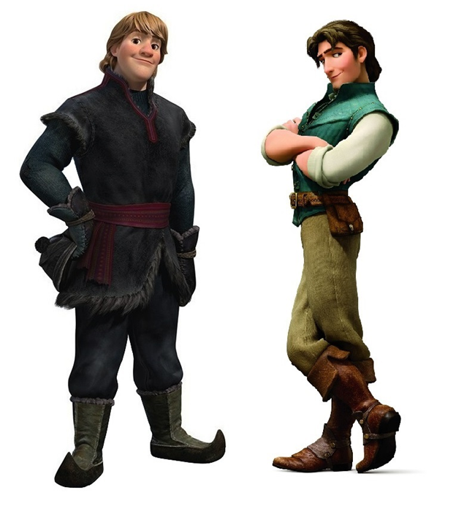
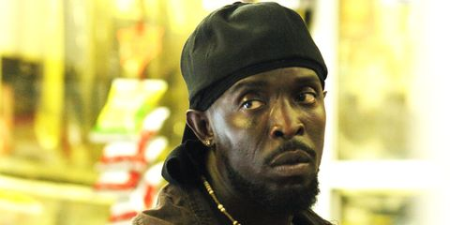
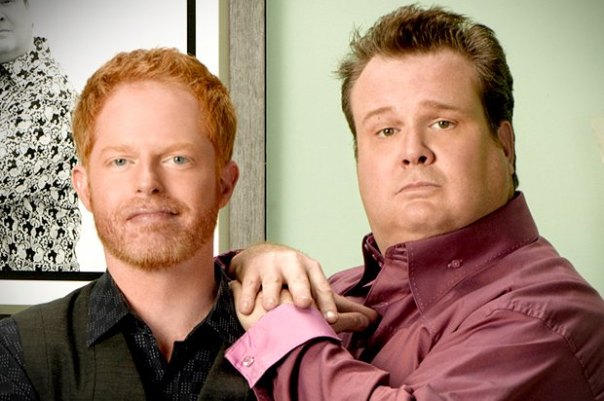
Masculinity
Newer, nontraditional male roles coexist with traditional roles:
  Traditional roles
    Violent
    Aggressive
    Thieves
    Murderers
    Abusers (domestic and sexual)
    Irresponsible
    Deadbeats

Slide 6
Masculinity
Does media represent these masculinities or constitute them?
Masculine narratives in media may lead to the destabilization of “masculinity”
  May allow male viewers to experience the ‘feminine’ pleasure that deconstructs the dominant ideology (Hanke, 1998).
Crisis of masculinity (Crider, 2014)
  …occurs when men, taken out of their traditional roles by feminism, feel conflicted about what type of masculinity will allow them to navigate the expectations of both sexes in all facets of their lives.
    Issues of
      Body image
      Self-esteem

Slide 7


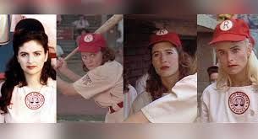

Femininity
Gender revisited
  Butler (1990)
    We understand gender through a complex of manipulated and manufactured codes and costumes rather than an inherent, essential, and prima facie.
      Gender Is found in the repetition of ritual
        Naturalization

Slide 8
Femininity
Women
  Representations in a patriarchal western society
    Objectified
    Sexualized
      Fetishized object of the male gaze
      Subservient roles in relation to men
    Invisible
    Under-represented
    Associated with domestic issues

Slide 9
Femininity
  Symbolic Annihilation (Tuchman, 1978)
    The omission, trivialization and condemnation of women by mass media

Slide 10
Femininity
Online femininity
  Zines
  Fan sites
  Instant Messaging

Slide 11
References
Crider, D., (2014). For Those (Men) About to Rock: Rock Radio and the Crisis of Masculinity, Journal of Radio & Audio Media, 21:2, 258-271, DOI: 10.1080/19376529.2014.946598
Dubrofsky, R.E. & Ryalls, E. D. (2014). The Hunger Games: Performing Not-performing to Authenticate Femininity and Whiteness, Critical Studies in Media Communication, 31:5, 395-409, DOI: 10.1080/15295036.2013.874038
Hoover, S. M., Coats, C.D., (2011). The Media and Male Identities: Audience Research in Media, Religion, and Masculinities, Journal of Communication, Volume 61, Issue 5, p. 877–895, https://doi.org/10.1111/j.1460-2466.2011.01583.x
Lundell, Å. K. l & Ekström, M. (2008.) THE COMPLEX VISUAL GENDERING OF POLITICAL WOMEN IN THE PRESS, Journalism Studies, 9:6, 891-910, DOI: 10.1080/14616700802227845
Shome, R., (2011). “Global Motherhood”: The Transnational Intimacies of White Femininity, Critical Studies in Media Communication, 28:5, 388-406, DOI: 10.1080/15295036.2011.589861
Yakalı-Çamoğlu, D. (2018). Characters from a Different Story: Media, Narratives of Love and Construction of Gender Identities in Children’s Worlds. 10.1163/9789004380233_006.

