Slide 1

Is That how they see me
Day 2
Hegemony and Ideology
Richard T. Craig, PhD
George Mason University

Slide 2
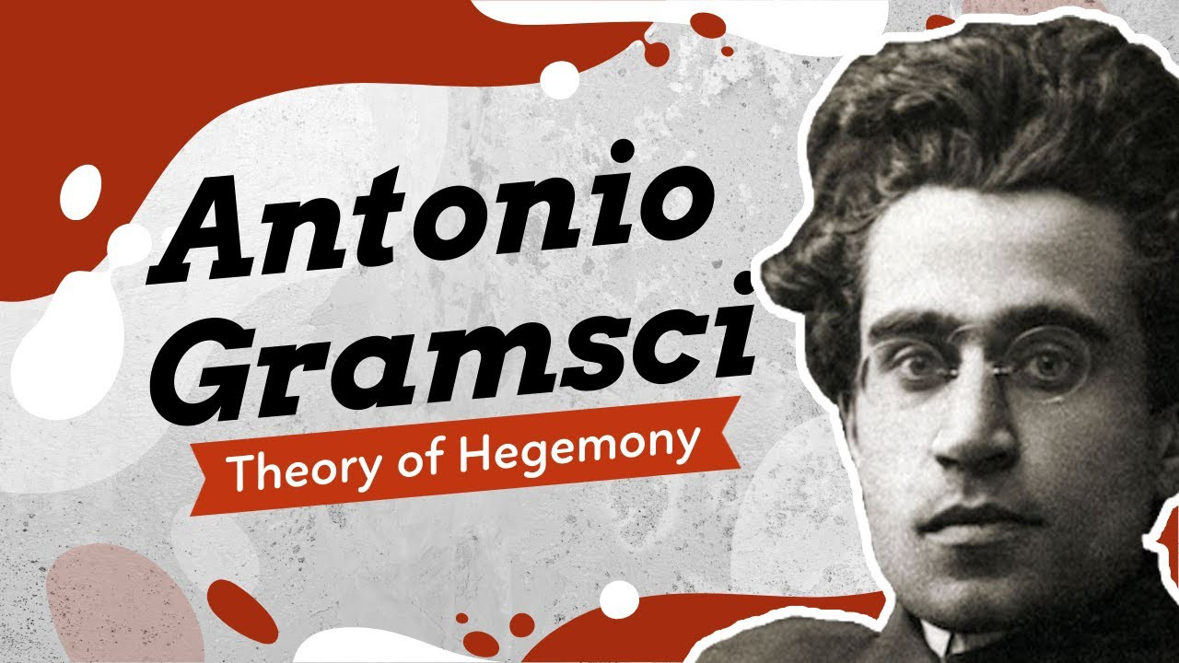
Hegemony
Origins of the term-
  Antonio Gramsci
    Draws attention to society’s “super structure”
      Struggles over meaning and Power
        Stems from Marxist notions of society
          Ruling classes who control society also control its political and primary ideological institution (Marx and Engels, 1960) {Cited in Altheide, 1984)

Slide 3
Hegemony
Defined
  “asymmetrical interdependence of political-economic-cultural relations between and among social classes within a nation (Lull, 1995)
Gramsci
  Hegemony is part Force and part Consent (Klein, 2016)

Slide 4
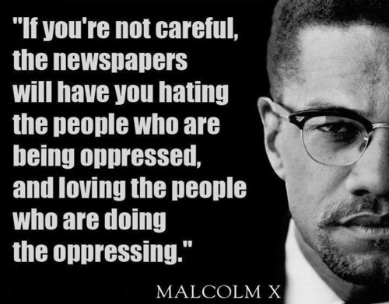
Media Hegemony
Media not a place of democracy, instead apparatuses of hegemony (Groshek and Han, 2011)
Media, are tools that ruling elites use to “perpetuate their power, wealth, and status (by popularizing} their own philosophy, culture and morality”
Media “introduces elements into individual consciousness that would not otherwise appear there, but will not be rejected by consciousness because they are so commonly shared in the cultural community”
  Stuart Hall (Cited in Altheide, 1984)
    Media products are messages in code about the nature of society, the nature of productive relations within the media themselves and institutional domains and social processes.
  Carrage (1993)
    …some researchers have argued that journalistic construction of reality legitimate and reinforce the existing political and social order
      Denigrate and inhibit dissent…

Slide 5
Hegemony
Stuart Hall on hegemony…
“framing of all competing definitions of reality within (the dominant class’) range bringing all alternatives within their horizons of thought. (The dominant class) sets the limits – mental and structural --- within which subordinate classes ‘live’ and make sense of their subordination in such a way as to sustain the dominance of those ruling over them”

Slide 6
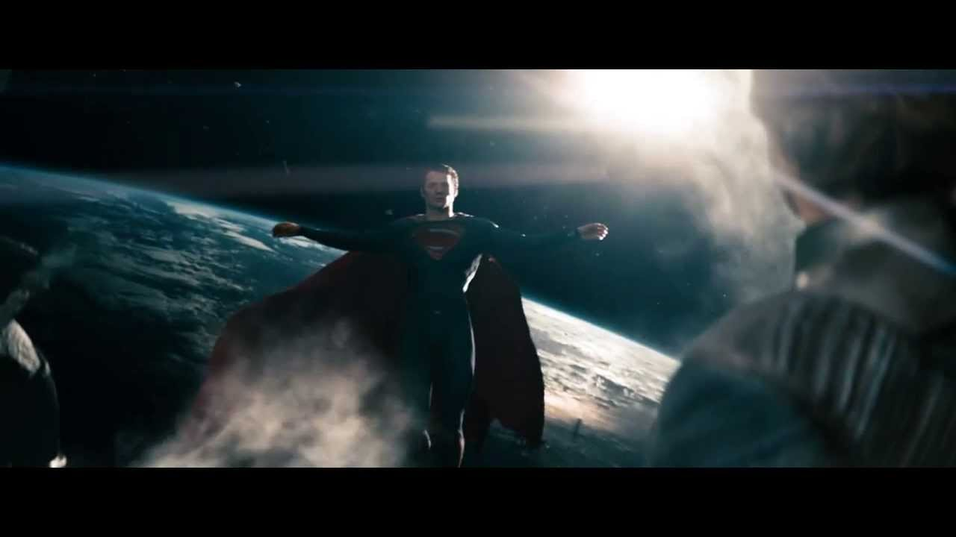
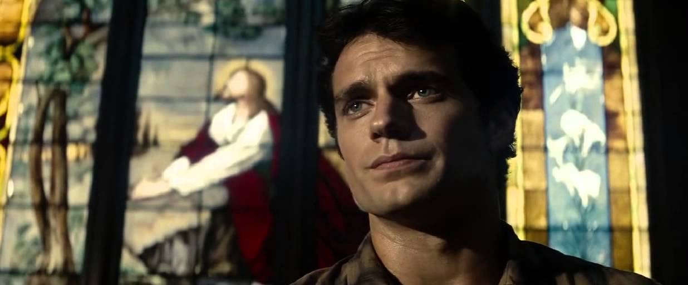
Hegemony…
Back to Gramsci (Lull ,1995)
Hegemony requires that ideological assertions become self-evident cultural assumptions. Its effectiveness depends on subordinated peoples accepting the dominant ideology as “normal reality or common sense…in active forms of experience and consciousness”
Hegemony can go undetected!!!

Slide 7
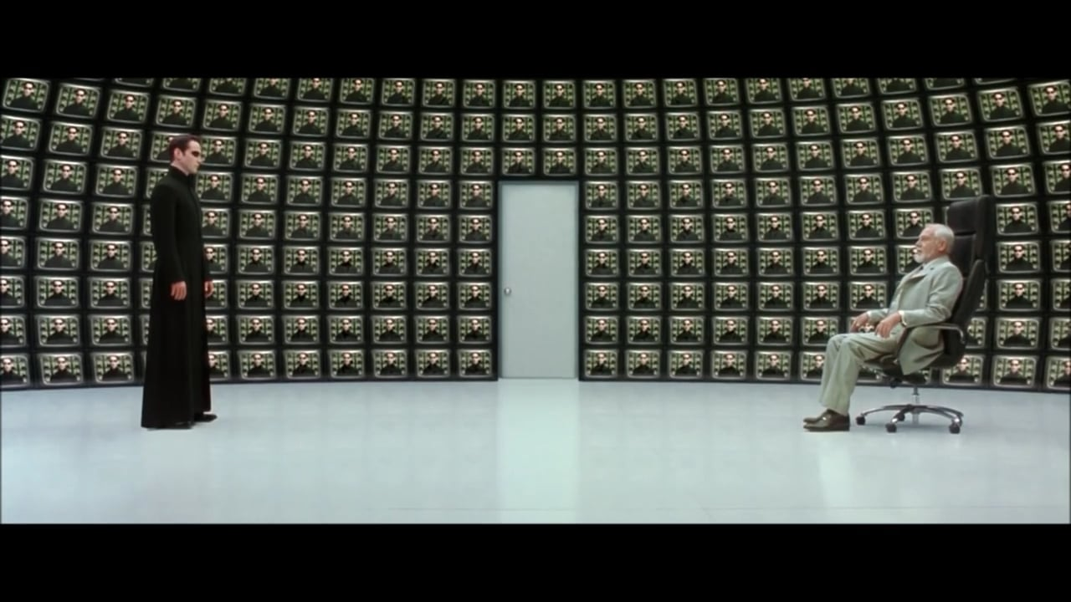
Hegemony
Counter-Hegemony
  Counter-culture…
    Resistance to power (Klein, 2016)
      Social movements
Hall
  Ideological counter-tendencies regularly appear in the seams and cracks of dominant forms…challenging central political positions and cultural assumptions.
    Rap music
    Rock music
    Graffiti
Alternative Media (Groesheck and Han, 2011)
  Power resistance

Slide 8
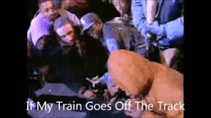
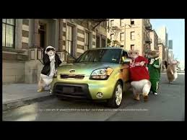
Resistance is Futile…

Slide 9
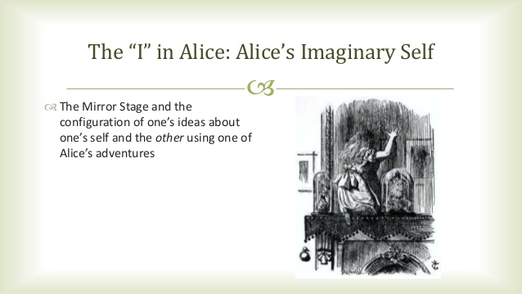
Ideology
Hall (2018)
  Ideology refers to those images, concepts and premises which provide the frameworks through which we represent, interpret, understand and ‘make sense’ of some aspect of social existence.
    Carriers of ideology
Althusser (Hemlatha, 2019)
  Ideological State Apparatus
    Social institutions serve to transmit ideologies
      Education
      Religion
      Family
      Trade Unions
      Law
      MEDIA

Slide 10
Social Institutions (Normalization)
Family
School
Government
Mass Media
Religion

Slide 11
Ideology
Ideologies do not consist of isolated and sperate concepts, but the articulation of different elements into a distinctive set or chain of meanings.
Ideological statements are made by individuals: but ideologies are not the product of individual consciousness or intention. Rather we formulate our intentions within ideology.
  Unconscious process
Ideologies work by constructing for their subjects (individual and collective) positions of identification and knowledge which allow them to utter ideological truths as if they were their authentic authors.

Slide 12
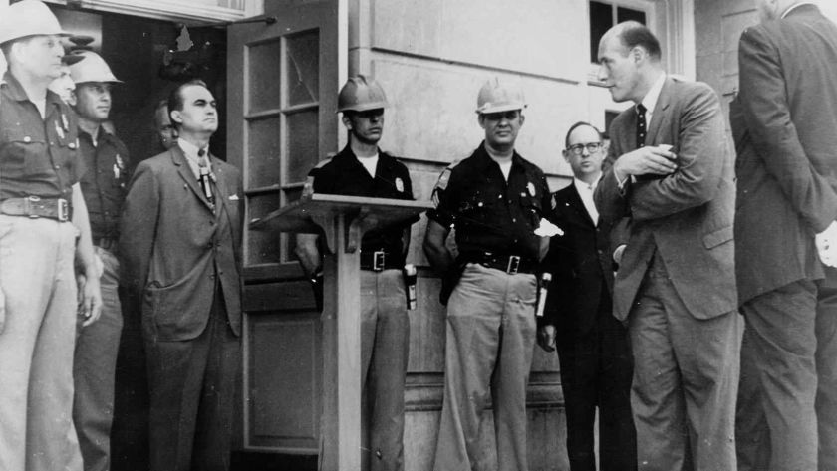
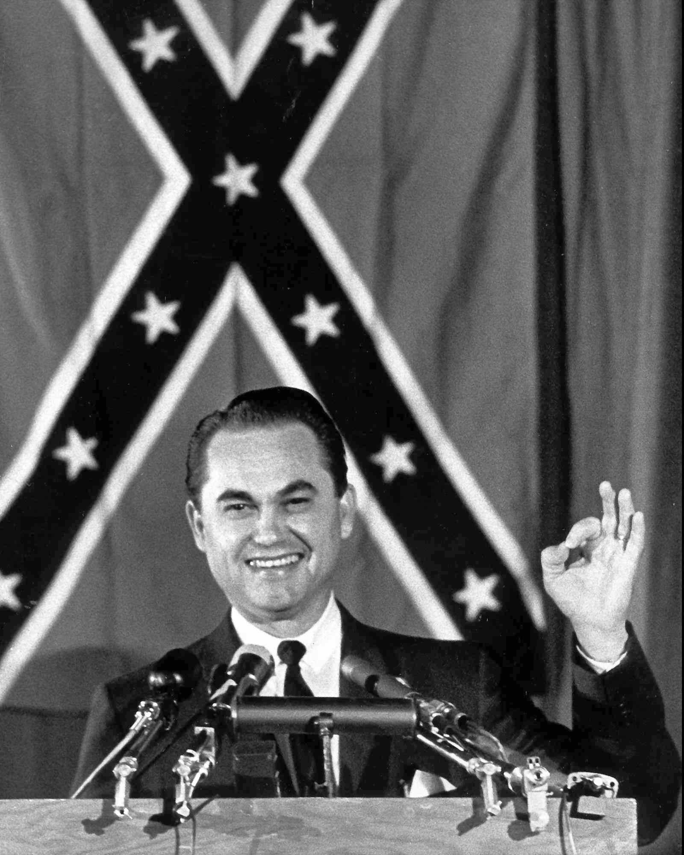
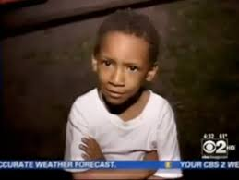
Ideology
Racism expressed (Hall, 2018)
  Overt
    Occssions when open and favorable coverage is given to arguments, positions and spokespersons who are in the business of elaborating an openly racist argument or advancing a racist policy or view.
  Inferrential
    Naturalized representations of events and situations relating to race, whether factual or fictional which have racist premises and propositions inscribed in them as a set of unquestioned assumptions

Slide 13
References
Altheide, D. L., (1984). Media Hegemony: A Failure of Perspective, Public Opinion Quarterly, Volume 48, Issue 2, Pages 476–490, https://doi.org/10.1086/268844
Carragee, K. M., (1993) A critical evaluation of debates examining the media hegemony thesis, Western Journal of Communication, 57:3, 330-348, DOI: 10.1080/10570319309374457
Groshek, J., & Han, Y. (2011). Negotiated Hegemony and Reconstructed Boundaries in Alternative Media Coverage of Globalization. International Journal Of Communication, 5, 22. Retrieved from https://ijoc.org/index.php/ijoc/article/view/1073
Hall, S. (2018). The whites of their eyes: Racist ideologies and the media. In Dines, G., Humez, J., Yousman, B., & Bindig, L. Gender, race, and class in media : a critical reader (Fifth edition.). (pp. 89-93). Thousand Oaks, California: SAGE Publications, Inc.
Hemalatha, M. (2019). Discourse and Context of Marginalism through Ideology and Ideological State Apparatus by Louis Althusser. Language in India, 19(9), 78–82.
Klein, A. (2016). Using the “wife-beater” shirt to teach about hegemony and counterhegemony, Communication Teacher, 30:2, 100-105, DOI: 10.1080/17404622.2016.1139149
Lull, J. (1995). Media, communication, culture: A global approach. Cambridge, UK: Polity Press, in association with Blackwell Publishers.

