Slide 1

Is That how they see me
Day 4
Sex and Sexuality
Dr. Richard T. Craig
George Mason University

Slide 2
Sex and Sexuality
SEX SELLS!!!

Slide 3
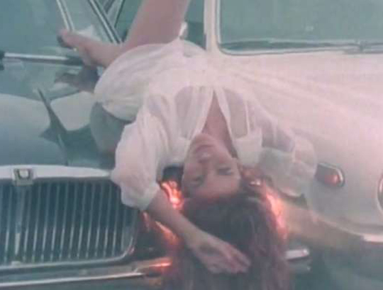
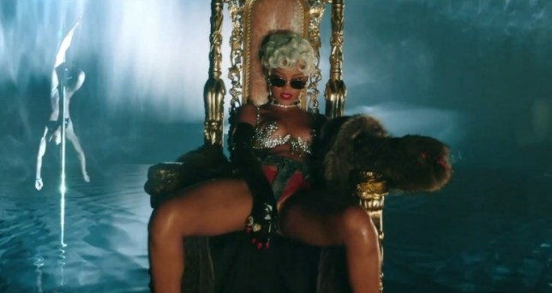
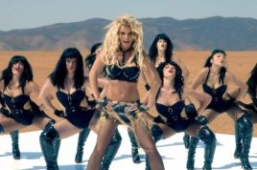
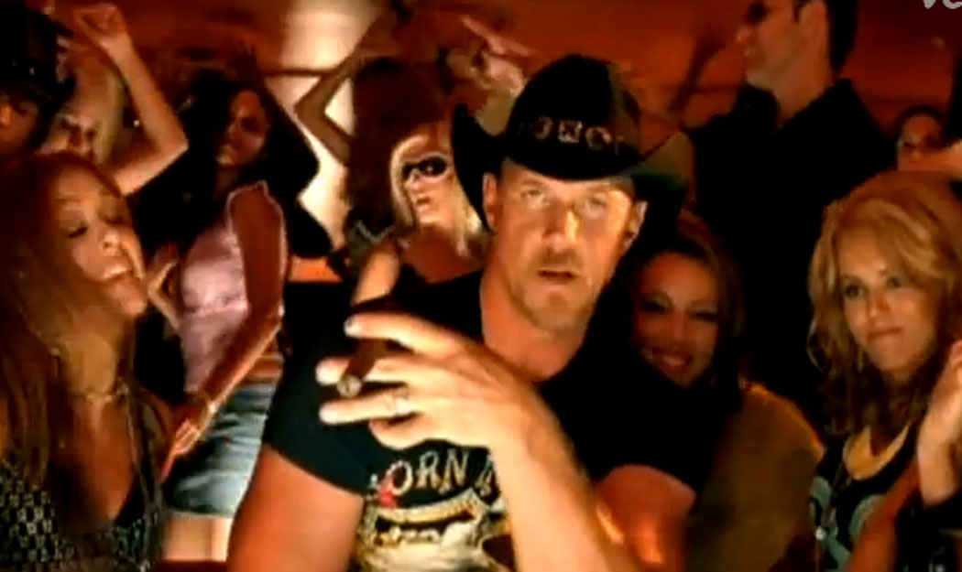
Sex Sells…
Mainstreaming of sex
  Music videos riddled with sex
    Research has shown that music videos are effective schematic priming agents for attitudes and beliefs about gender and sexuality (Aubrey, 2011)

Slide 4
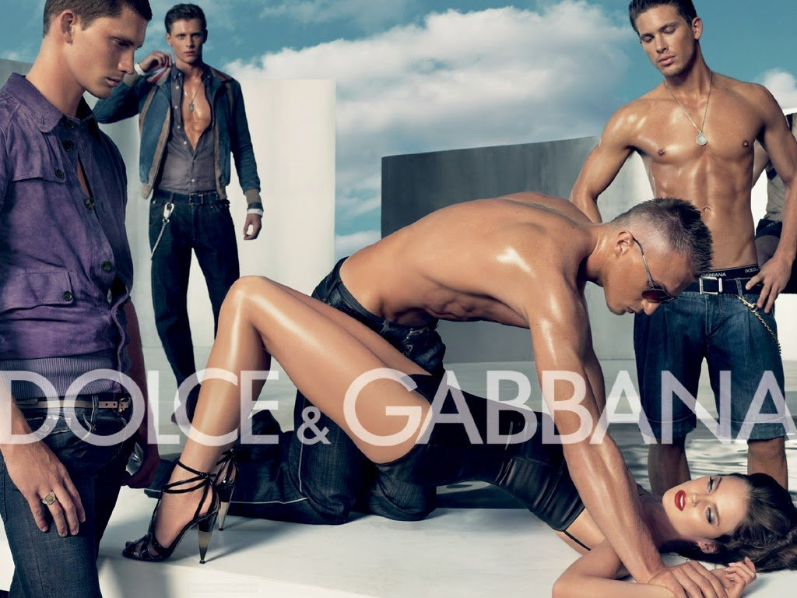
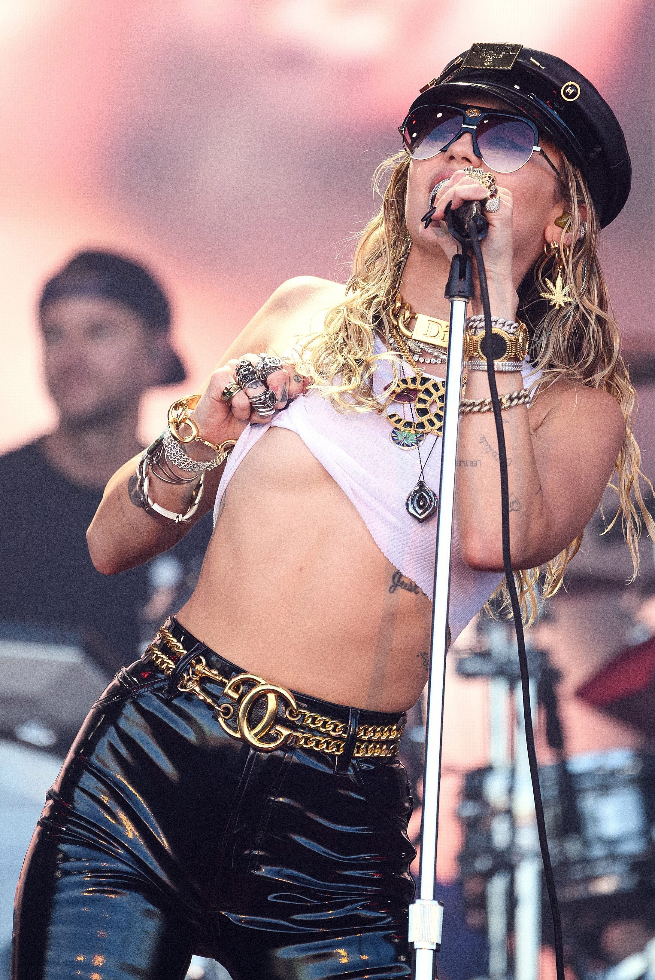
Sexualization
American Psychological Association
  Designates sexualization as something that happens to women and girls.
    In this frame then …sexualization is a byproduct of power relationships…
Gill (2012) See Jackson and Vares
  Sexualization = saturation of sexual representation and discourses, and in which pornography has become increasingly influential and porous…to the point of permeating mainstream contemporary culture.

Slide 5
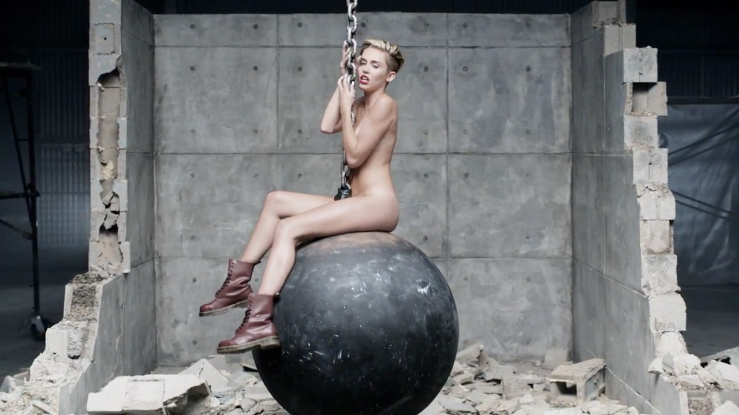
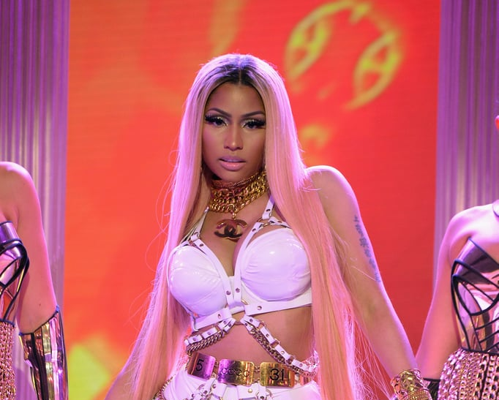
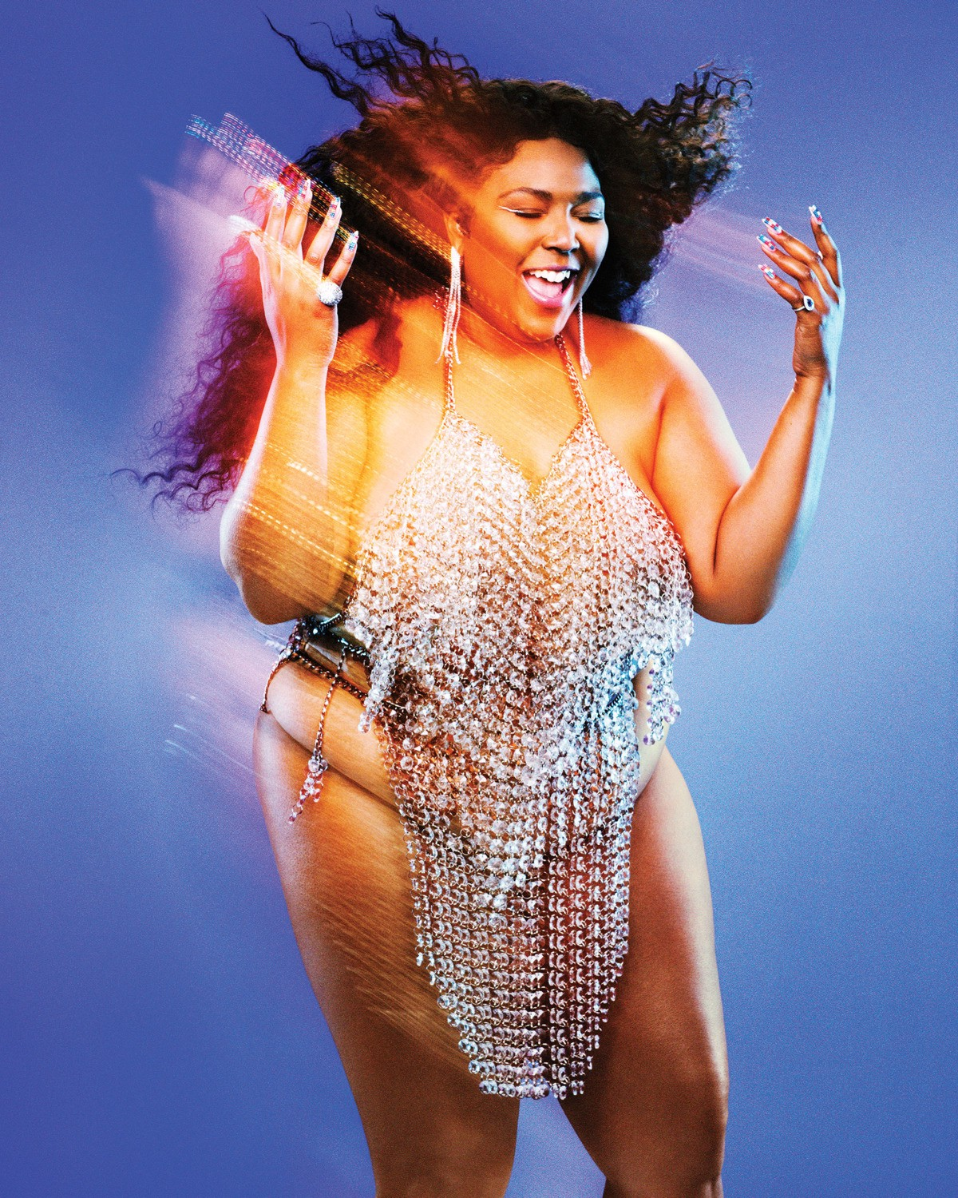
Sexualization
Sexualization occurs when (Aubrey, 2017)
  A persons’ value comes from her sexual appeal and not from other characteristics
  A person’s attractiveness is inextricably linked to her sexual appeal
  A person is sexually objectified (made into a thing for others sexual use)
  A person has sexuality inappropriately imposed upon the self
Self-sexualization
    Empowering
    Reflect sexual power
    Infers artist has control of their sexuality
    Self-sexualization
      A choice that girls and women make to conform to norms of sexiness in culture in order to get rewards (APA 2007; Lamb et al., 2013)

Slide 6
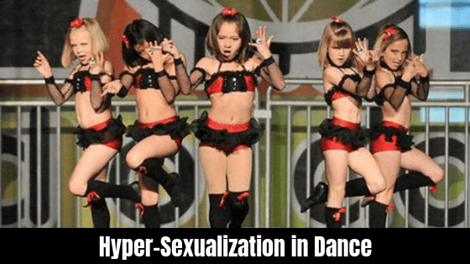
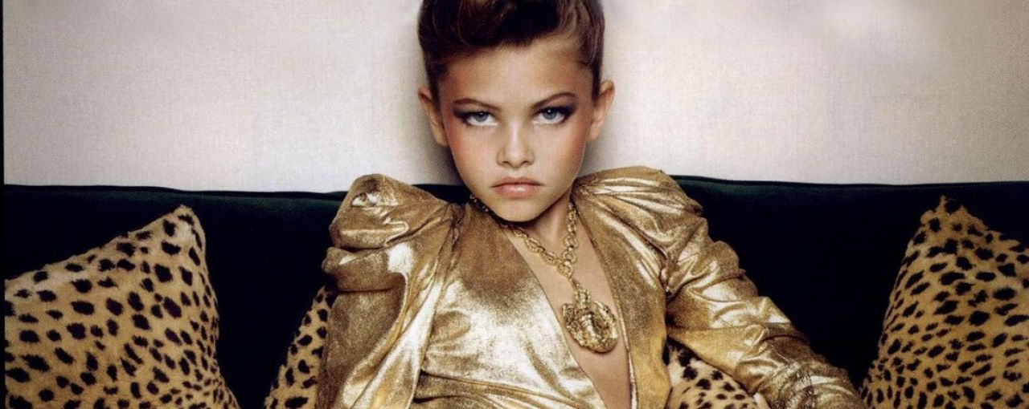
Hypersexualization
Feminine Hypersexualization
    Incited moral panic
  Pervasive in media

Slide 7
Pornification
Pornography increasingly deregulated in U.S.
  Youth draw on “porno-discourses” in the development of their sexual identity (Ringrose, 2011)
    New found sexual agency
      How does this impact young women and men?
Normalization of sexually explicit content…
  Normalization of pornography
Porno-chic Styling (Attwood, 2009) see Jackson and Vares
  A porn-styled aesthetic in fashion
    Hyper-femininity (stelleto heels, heavy make-up)
    Hypersexuality (body-exposing and/or clothing emphasizing breast and hips)
    Perpetually sexually desiring (being “up for it”)

Slide 8
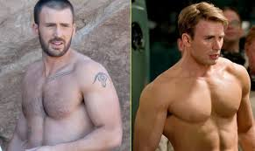
Sexualization…
If it’s about power…Can the male body be sexualized?...

Slide 9
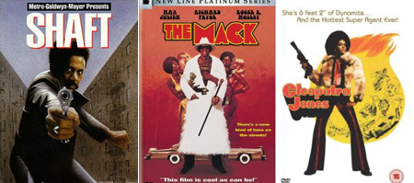

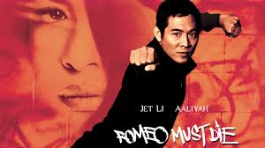
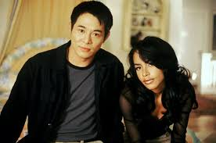
Sexualization
If it’s about power…Can the male body be sexualized?...
Sexualization of the “Other”
  The Black “Other” based on systems of
    Sexual exploitation
    Commodification
    Stereotypes
    Ideologies of promiscuity
  Latin(x)
    Exoticizing
    Tropicalizing
Desexualization
  Of the Asian Male Body

Slide 10
Sex and Sexuality…
But what kind of sex sells?
Does all sex sell equality?

Slide 11

LGBTQ
Who was the first outwardly gay male or female character in TV?
Same Sex Marriage
How often do we see same sex couples engage in physical/sexual behavior?

Slide 12
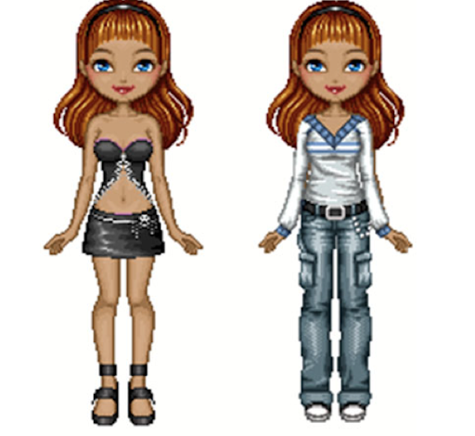
21st century and on…
With new digital media people are actively negotiating and performing sexual identity, while actively constructing online profiles, avatars, etc… (Ringrose, 2011)

Slide 13
References
Aubrey, J. S., Gamble, H., & Hahn, R. (2017). Empowered Sexual Objects? The Priming Influence of Self-Sexualization on Thoughts and Beliefs Related to Gender, Sex, and Power. Western Journal of Communication, 81(3), 362–384. https://doi-org.mutex.gmu.edu/10.1080/10570314.2016.1257822
Lamb, S., Graling, K., & Wheeler, E. E. (2013). ‘Pole-arized’ discourse: An analysis of responses to Miley Cyrus’s Teen Choice Awards pole dance. Feminism & Psychology, 23(2), 163–183. https://doi.org/10.1177/0959353512472482
Jackson, S., & Vares, T. (2015). ‘Too many bad role models for us girls’: Girls, female pop celebrities and ‘sexualization.’ Sexualities, 18(4), 480–498. https://doi.org/10.1177/1363460714550905
McDade-Montez, E., Wallander, J. & Cameron, L. (2017). Sexualization in U.S. Latina and White Girls’ Preferred Children’s Television Programs. Sex Roles 77, 1–15 https://doi.org/10.1007/s11199-016-0692-0
Ringrose, J. (2011). Gendered risks and opportunities? Exploring teen girls’ digitized sexual identities in postfeminist media contexts. International Journal of Media & Cultural Politics, 7(2), 121–138. https://doi-org.mutex.gmu.edu/10.1386/macp.7.2.121_1

